Slide 1

Different Parts of Supplemental Nutrition Assistance Program (SNAP) Leads to Modest Changes in Food Security of Low-income Households
Ronglu Jiang, Xuanlong Liang, Hanbing Lu, Yumeng Tian, Shanrong Zhou, Ruizhe Zhu

Slide 2
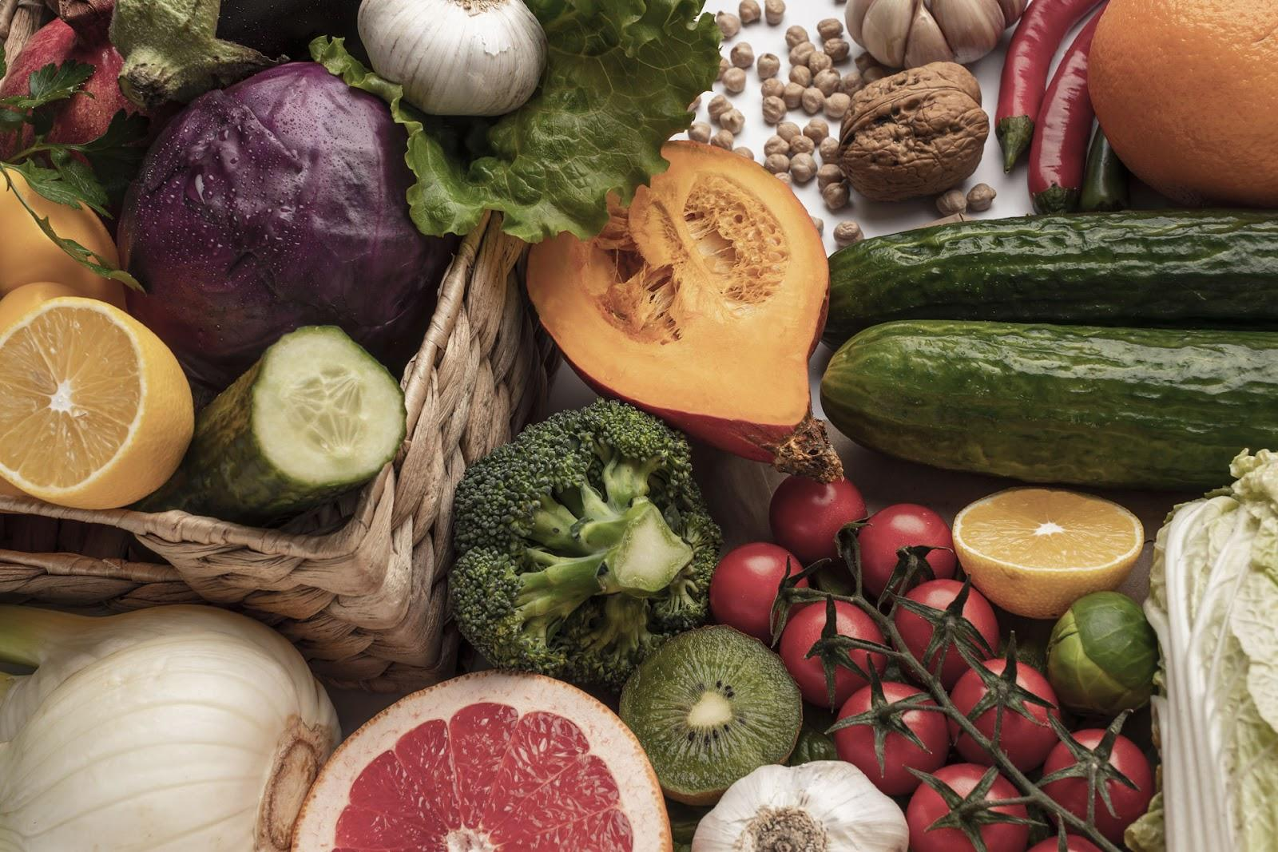
01
Research Proposal

Slide 3

Abstract
The U.S. Department of Agriculture (USDA) introduced the Supplemental Nutrition Assistance Program (SNAP) which gives vulnerable households a monetary subsidy to improve food insecurity. The extension of SNAP, SNAP-Ed, provides low cost, and easy-to-prepare recipes and nutrition education materials that teach people to plan, shop, cook, and save to improve their health.This research examined:
whether SNAP’s food subsidy improves the food security status for program participants and
whether SNAP-Ed leads to improvement of food security in low-income households. The objective of the research is to determine the impact of SNAP on low-income households and hence the need to involve eligible non-SNAP participants for comparison purposes.
Participants who had been in the program over the prior 6-7 months and new-entrant households involved the following four cohorts, SNAP participants will be randomized to one of the 2)-4) conditions:
A control group: non-SNAP participants who have experienced persistent poverty;
Participants receive only food subsidies;
Participants receive only food subsidies and education on food preparation and nutrition;
Participants receive only food subsidies and a healthy recipes.
Participants completed a suggested survey module developed by the U.S. Department of Agriculture, which are measured as indicators of their food security status and well-being.

Slide 4
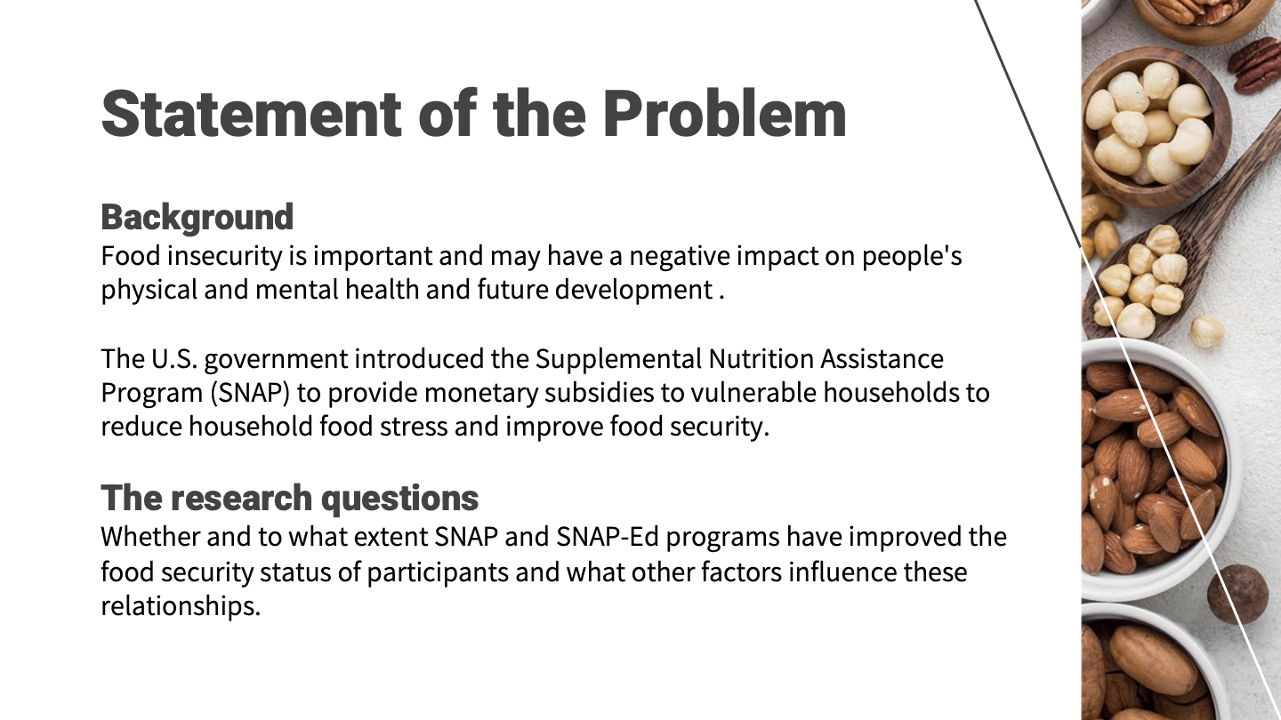

Slide 5
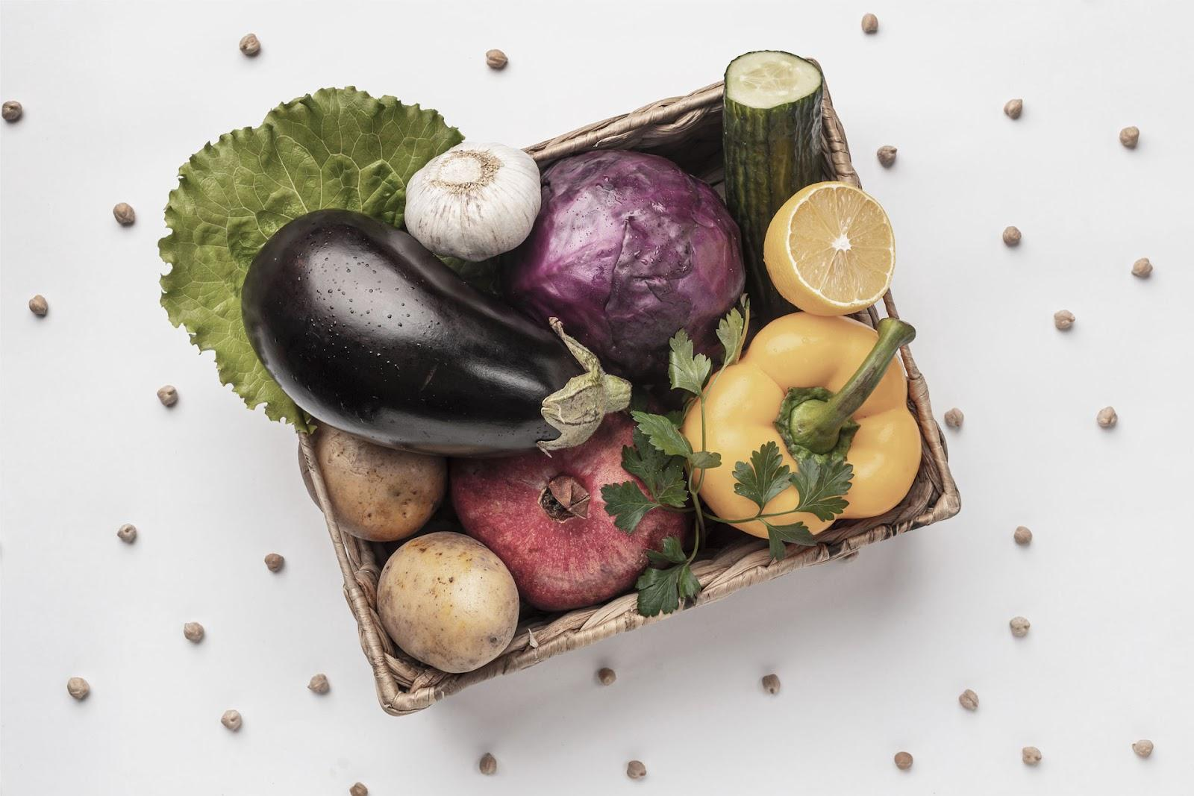
Importance of the Study and Social Impact
leads to improvement of food security in low-income households helps USDA to have a preliminary understanding of the effectiveness of each subproject in SNAP, and provides support for the general direction of which subproject to invest or reduce in the future. Future decision makers of the SNAP program can find insights from the result of the research and develop more effective policies supporting low-income families to reach food security and food sufficiency after the COVID-19 pandemic with limited resources.

Slide 6
Literature Review
However, whether the specific parts of SNAP-Ed would have different effects on food security has not been widely studied yet.
Author/Publication & Year | Conclusion | SNAP’s Effect | SNAP-Ed’s Effect
Mabli, J., & Worthington, J. (2014) | SNAP has improved child food security
Mabli, J., & Ohls, J. (2014) | SNAP has improved food security for national households
Center on Budget and Policy Priorities (2022) | SNAP helps low-income Americans access a nutritionally balanced diet
Adedokun, O. A., Plonski, P., Jenkins-Howard, B., Cotterill, D. B., & Vail, A. (2018) | SNAP-Ed has improved participants’ food resource management skills and food safety practices

Slide 7

Research Question
The study was designed to answer the following questions:
Does SNAP’s food subsidy improve the food security status and well-being for program participants?
Do the SNAP-Ed recipes recommended diet have a positive effect on the food security status and well-being of program participants?
Do the nutrition education materials offered by SNAP-Ed improve participating households’ food security and well-being?

Slide 8
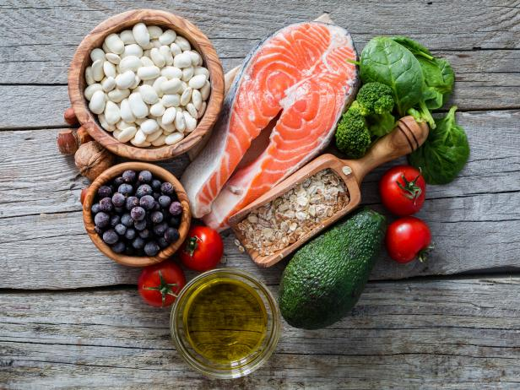
Population of Interest
Persons who are low-income earners or live below the federal poverty line threshold (130 percent).
The study populations included all households eligible for SNAP benefits based on the income and resources criterion.
Income ≤ 130% poverty line before any program deductions are made.
Income ≤ 130% poverty line after any program deductions are made.
Assets < specific limits, including without member ≥ 60 years old and disabled member.

Slide 9

Sample Selection
In this study, research will evaluate the sample’s baseline characteristics using self-identification with US census categories.
We will collect data on SNAP participants in a survey. In the study survey, three questions will be asked to determine sample participants (the inclusion criteria).
These inclusion criteria help reduce the study population groups by eliminating participants not fit for inclusion in each study cohort.
Participants who had been in the program over the prior 6-7 months and new-entrant households thus involved four cohorts.
The selection is critically based on income.

Slide 10

Sample Size & Statistical Power
H0:μT − μC ≤ 0: The study hypothesized that SNAP benefits improve the food security status and well-being of the program participants.
Set statistical power = 90%.
We assumed that effect size=2, confidence level=95%, standard deviation=10 and level of significance =95%.
Given that the α =0.05 we will reject the null hypothesis is Z >Z(1-0.05) = 1.645
n = {[z1−α−Φ-1 (β)]/ μA/σ}^2
Then n= (1.645-(-1.28)/2/ 10)^2 = 855.5625

Slide 11
Operational Procedures
Process of conducting the study:
We will request USDA approval and will work with the SNAP program director.
Recruited subjects will be randomly assigned to treatment groups and will receive different treatments for 6 consecutive months.
The study will conduct an online survey to assess participants' food security status and well-being after the six months .
Subjects in the control group will be recruited via Survey Sampling International.
Subjects in the treatment groups will take the survey via official SNAP email.
Risk of Bias:
Participants in the control group who are most affected by food insecurity would be more likely to complete the survey.
Participants in the treatment groups who have strong positive or negative opinions about the program would be more likely to complete the survey.
Rewards: Participants will receive a variety of rewards, including cash, food vouchers and lottery tickets.
Training: The data collection team will be trained over two consecutive days prior to collecting the data.

Slide 12
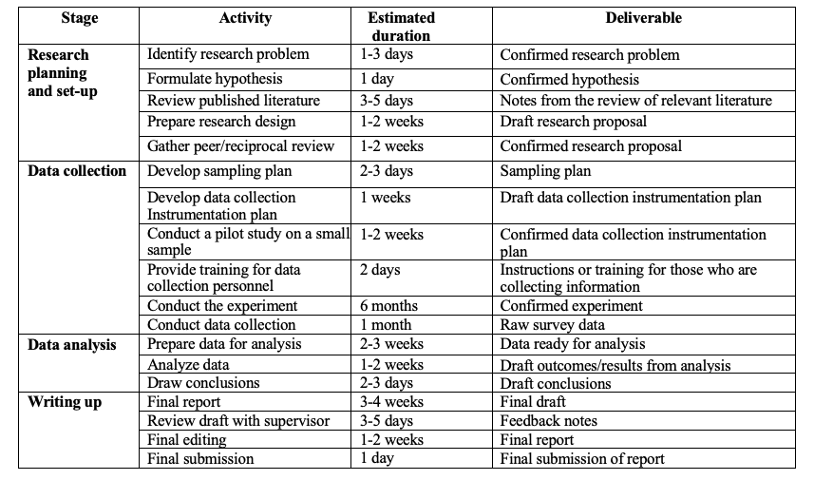
Brief Schedule
The estimated maximum duration of the project is ~ 359 days.
The estimated minimum duration of the project is ~ 302 days.

Slide 13
Data Collection - six-item short form of the food security survey module developed by the U.S. Department of Agriculture
Topic | Questions | Metric of Performance
Household Food Situation | “The food that (I/we) bought just didn’t last, and (I/we) didn’t have money to get more.” Was that often, sometimes, or never true for (you/your household) in the last 12 months? “(I/we) couldn’t afford to eat balanced meals.” Was that often, sometimes, or never true for (you/your household) in the last 12 months? | Households with high or marginal food security (0-1 affirmative responses) Households with low food security (2-4 affirmative responses) Households with very low food security (5-6 affirmative responses)
Affordability and Meal Size | “In the last 12 months, since last (name of current month), did (you/you or other adults in your household) ever cut the size of your meals or skip meals because there wasn't enough money for food?” “[IF YES ABOVE, ASK] How often did this happen—almost every month, some months but not every month, or in only 1 or 2 months?” “In the last 12 months, did you ever eat less than you felt you should because there wasn't enough money for food?” “In the last 12 months, were you every hungry but didn't eat because there wasn't enough money for food?”

Slide 14
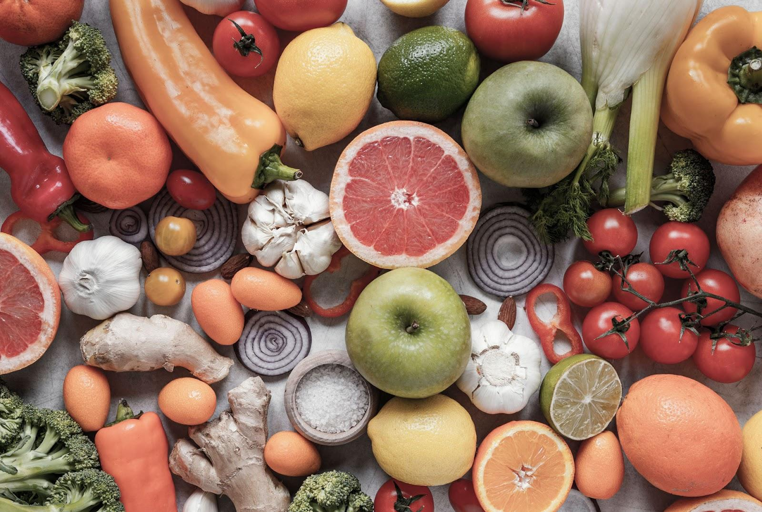
Data Collection - additional three survey questions
Well-being indicators (on a scale 0-6)
Healthy life
Weight Loss
Diabetes
& Hypertension
The expected average completion time is ~ 15 minutes

Slide 15
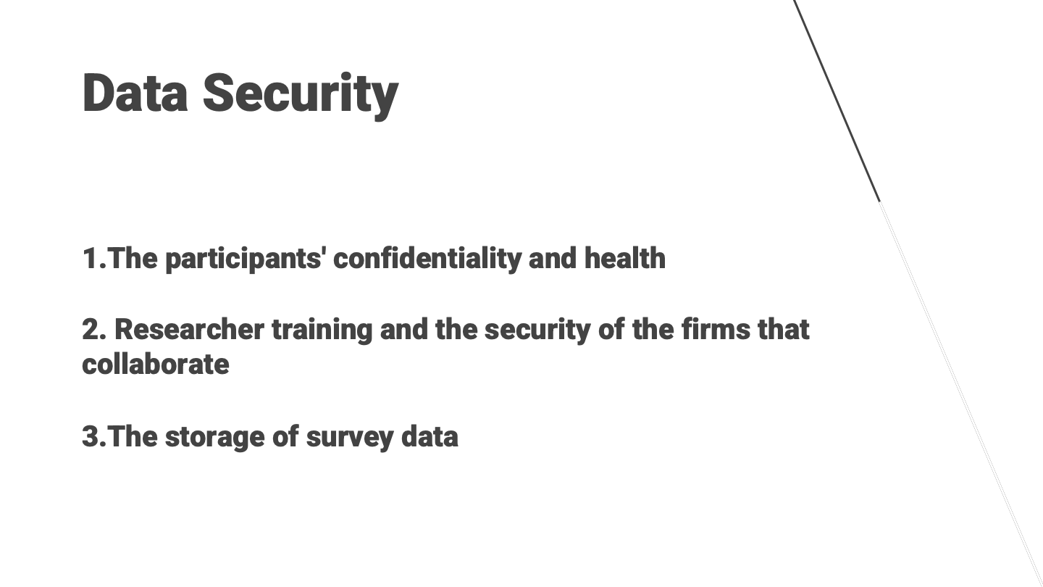

Slide 16
Variables
Dependent Variables (SF)
Independent Variables
Other Variables
Food Security Status (S_{F}):
sum of affirmative responses for food insecurity questions
(range: 0~6)
Welling-being Indicators (S₂):
average score of well-being measurement questions
(range: 0~6)
SNAP Participation Status:
Treatment Groups:
1)SNAP participants (food subsidy only)
2)SNAP participants (food subsidy + education on food preparation),
3)SNAP participants (food subsidy + education on healthy diet)
Control Group:
4)Non-SNAP participants
Demographic Factors:
gender, age, height, weight, ethnicity, race, education level, occupation, history of illness in the household, and the state or region in which they reside in the United States.

Slide 17
Statistical Analysis Plan
Mean Test
Alternative Test
Other Choices
S_{F}(Low (6) to High(0)) is transformed to S₁( Low(0) to High(6))
Dependent Variable used: S_{T} = S₁ + S₂ ; (S₁: Transformed Food Security Score; S₂: Well-being Score)
Purpose: To reflect small improvements caused by the each component of SNAP Program
One-sided Two Sample t-test
Test whether significant improvement exists
ANOVA + Linear Regression
Accounts for potential Confounding Variables
Proportion Test
Can be applied if using categorical dependent variable

Slide 18
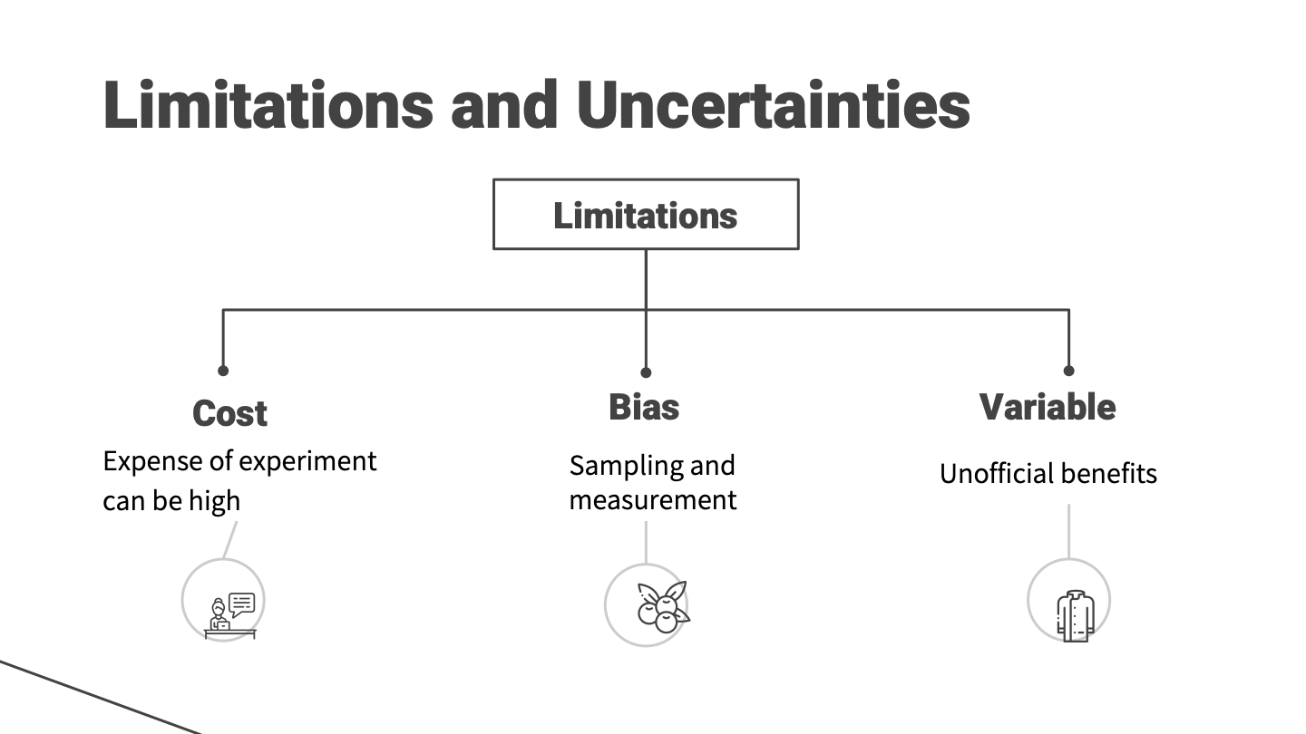

Slide 19
Simulation of Effects
02

Slide 20
Simulations - Results from 1000 simulated studies
Premise: 1). Power: 0.9; 2). Sample Size: 900 per group
 | Research Question | Scenario | Mean Effect | 95% CI of Mean Effect | % of False Positives | % of True Negatives | % of False Negatives | % of True Positives
1 | Question 1 | No Effect | 0.001108 | [-0.3132, 0.3154] | 5.1% | 94.9% | - | -
2 | Question 1 | Effect | 0.22416 | [-0.0803, 0.5367] | - | - | 56.8% | 43.2%
3 | Question 2 | No Effect | 0.002935 | [-0.3098, 0.3157] | 5.4% | 94.6% | - | -
4 | Question 2 | Effect | 0.116618 | [-0.1952, 0.4285] | - | - | 81.4% | 18.6%
5 | Question 3 | No Effect | 0.008035 | [-0.3017, 0.3178] | 5.3% | 94.7% | - | -
6 | Question 3 | Effect | 0.11453 | [-0.1836, 0.4277] | - | - | 80.4% | 19.6%

Slide 21
Key Findings from the Simulation
Perform well in scenario 1 (no effect) - High Percentage of True Negatives
Poor performance in scenario 2 (Effect) - Low Percentage of True Positives
The smaller the effect size, the lower percentage of True Positives
Possible solution - Pick a higher significance level for example 0.1

Slide 22
Sensitivity Test - Smaller Assumed Standard Error leads to higher % of True Positives with tiny change in % of True Negatives
SE=6 | Research Question | Scenario | Mean Effect | 95% CI of Mean Effect | % of False Positives | % of True Negatives | % of False Negatives | % of True Positives
1 | Question 1 | No Effect | -0.0019454 | [-0.2890, 0.2851] | 4.5% | 95.5% | - | -
2 | Question 1 | Effect | 0.57412 | [0.28130, 0.8669] | - | - | 2% | 98%
3 | Question 2 | No Effect | 0.0003583 | [-0.2934, 0.2941] | 5.2% | 94.8% | - | -
4 | Question 2 | Effect | 0.2799 | [-0.0218, 0.5816] | - | - | 42% | 58%
5 | Question 3 | No Effect | 0.00838 | [-0.2961, 0.3128] | 6.6% | 93.4% | - | -
6 | Question 3 | Effect | 0.2846 | [0.0055, 0.5747] | - | - | 40.1% | 59.9%

Slide 23

Thanks!

Slide 24
Reference
Policy basics: The Supplemental Nutrition Assistance Program (SNAP). Center on Budget and Policy Priorities. (n.d.). Retrieved October 15, 2022, from https://www.cbpp.org/research/food-assistance/the-supplemental-nutrition-assistance-program-snap
Adedokun, O. A., Plonski, P., Jenkins-Howard, B., Cotterill, D. B., & Vail, A. (2018). Healthy choices for every body adult curriculum improves participants' Food Resource Management Skills and Food Safety Practices. Journal of Nutrition Education and Behavior, 50(6), 638–644. https://doi.org/10.1016/j.jneb.2018.02.005
Mello, J. A., Gans, K. M., Risica, P. M., Kirtania, U., Strolla, L. O., & Fournier, L. (2010, December). How is food insecurity associated with dietary behaviors? an analysis with low-income, ethnically diverse participants in a nutrition intervention study. Journal of the American Dietetic Association. Retrieved October 15, 2022, from https://www.ncbi.nlm.nih.gov/pmc/articles/PMC3005628/
Six-Item Short form food security survey module - USDA. (n.d.). Retrieved December 4, 2022, from https://www.ers.usda.gov/media/8282/short2012.pdf
Falk, G., & Aussenberg, R. A. (2014). The supplemental nutrition assistance program (SNAP): Categorical eligibility.
Pollard, K., & Jacobsen, L. A. (2020). The Appalachian Region: A Data Overview from the 2014-2018 American Community Survey. Chartbook. Appalachian Regional Commission.
Holben, D. (2010). Position of the American Dietetic Association: food insecurity in the United States. Journal of the American Dietetic Association, 110(9), 1368-1377.
Coleman-Jensen, A., Gregory, C., & Singh, A. (2014). Household food security in the United States in 2013. USDA-ERS Economic Research Report, (173).
Food Security in the United States. USDA ERS - Food Security in the United States. (n.d.). Retrieved October 15, 2022, from https://www.ers.usda.gov/data-products/food-security-in-the-united-states/
U.S. Poverty Statistics. Federal Safety Net. (2022, September 20). Retrieved October 15, 2022, from https://federalsafetynet.com/poverty-statistics/#:~:text=%E2%80%8BFull%20U.S.%20Poverty%20Statistics,the%20year%202021%20was%2011.6%25.
Mabli, J., & Worthington, J. (2014). Supplemental Nutrition Assistance Program Participation and Child Food Security. Pediatrics, 133(4), 610–619. https://doi.org/10.1542/peds.2013-2823
Mabli, J., & Ohls, J. (2014). Supplemental nutrition assistance program participation is associated with an increase in household food security in a national evaluation. The Journal of Nutrition, 145(2), 344–351. https://doi.org/10.3945/jn.114.198697
Anders, J., & Rafkin, C. (2022). The welfare effects of eligibility expansions: theory and evidence from SNAP. Available at SSRN 4140433.

